Slide 1
AI Situational Awareness Foundation for Advancing Automation — AISA
Tomislav Radišić, PC, University of Zagreb
Ruth Häusler Hermann, Zurich University of Applied Sciencese
EASN, Barcelona ES, Oct 20 2022

Slide 2
AISA Objectives
Increase the possibility for introduction of automation ATM
Explore the effects of human-machine distributed situational awareness
Improve transparency and explainability
Investigate methods for adaptation of the automated system

Slide 3
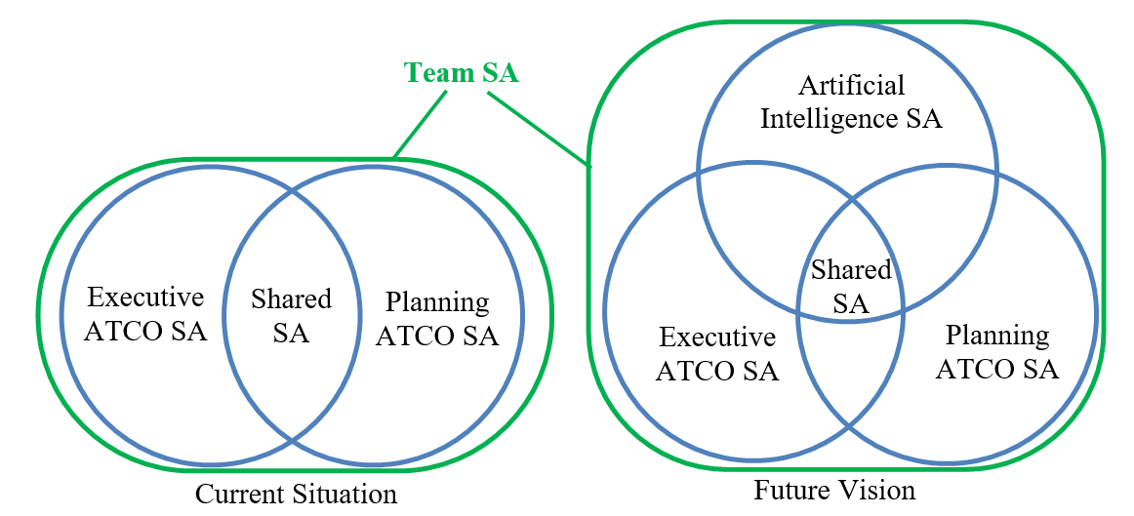
AISA Framework
Situational awareness or situation awareness (SA) is the perception of environmental elements and events with respect to time or space, the comprehension of their meaning, and the projection of their future status.
- Endsley
Artificial Situational Awareness as a Foundation for Further Automation

Slide 4
Aware of What?
AISA should be aware of:
the traffic situation
its own (system’s) state
other team member’s states
Caveat: Significant difference between AISA project goals and envisioned application of AISA in 2035 or 2040/2050

Slide 5







Knowledge-graph
Reasoning Engine
Proof-of-Concept System
SWIM Information Exchange Models
Knowledge-graph
Machine-learning Modules
DOMAIN EXPERTS

Slide 6
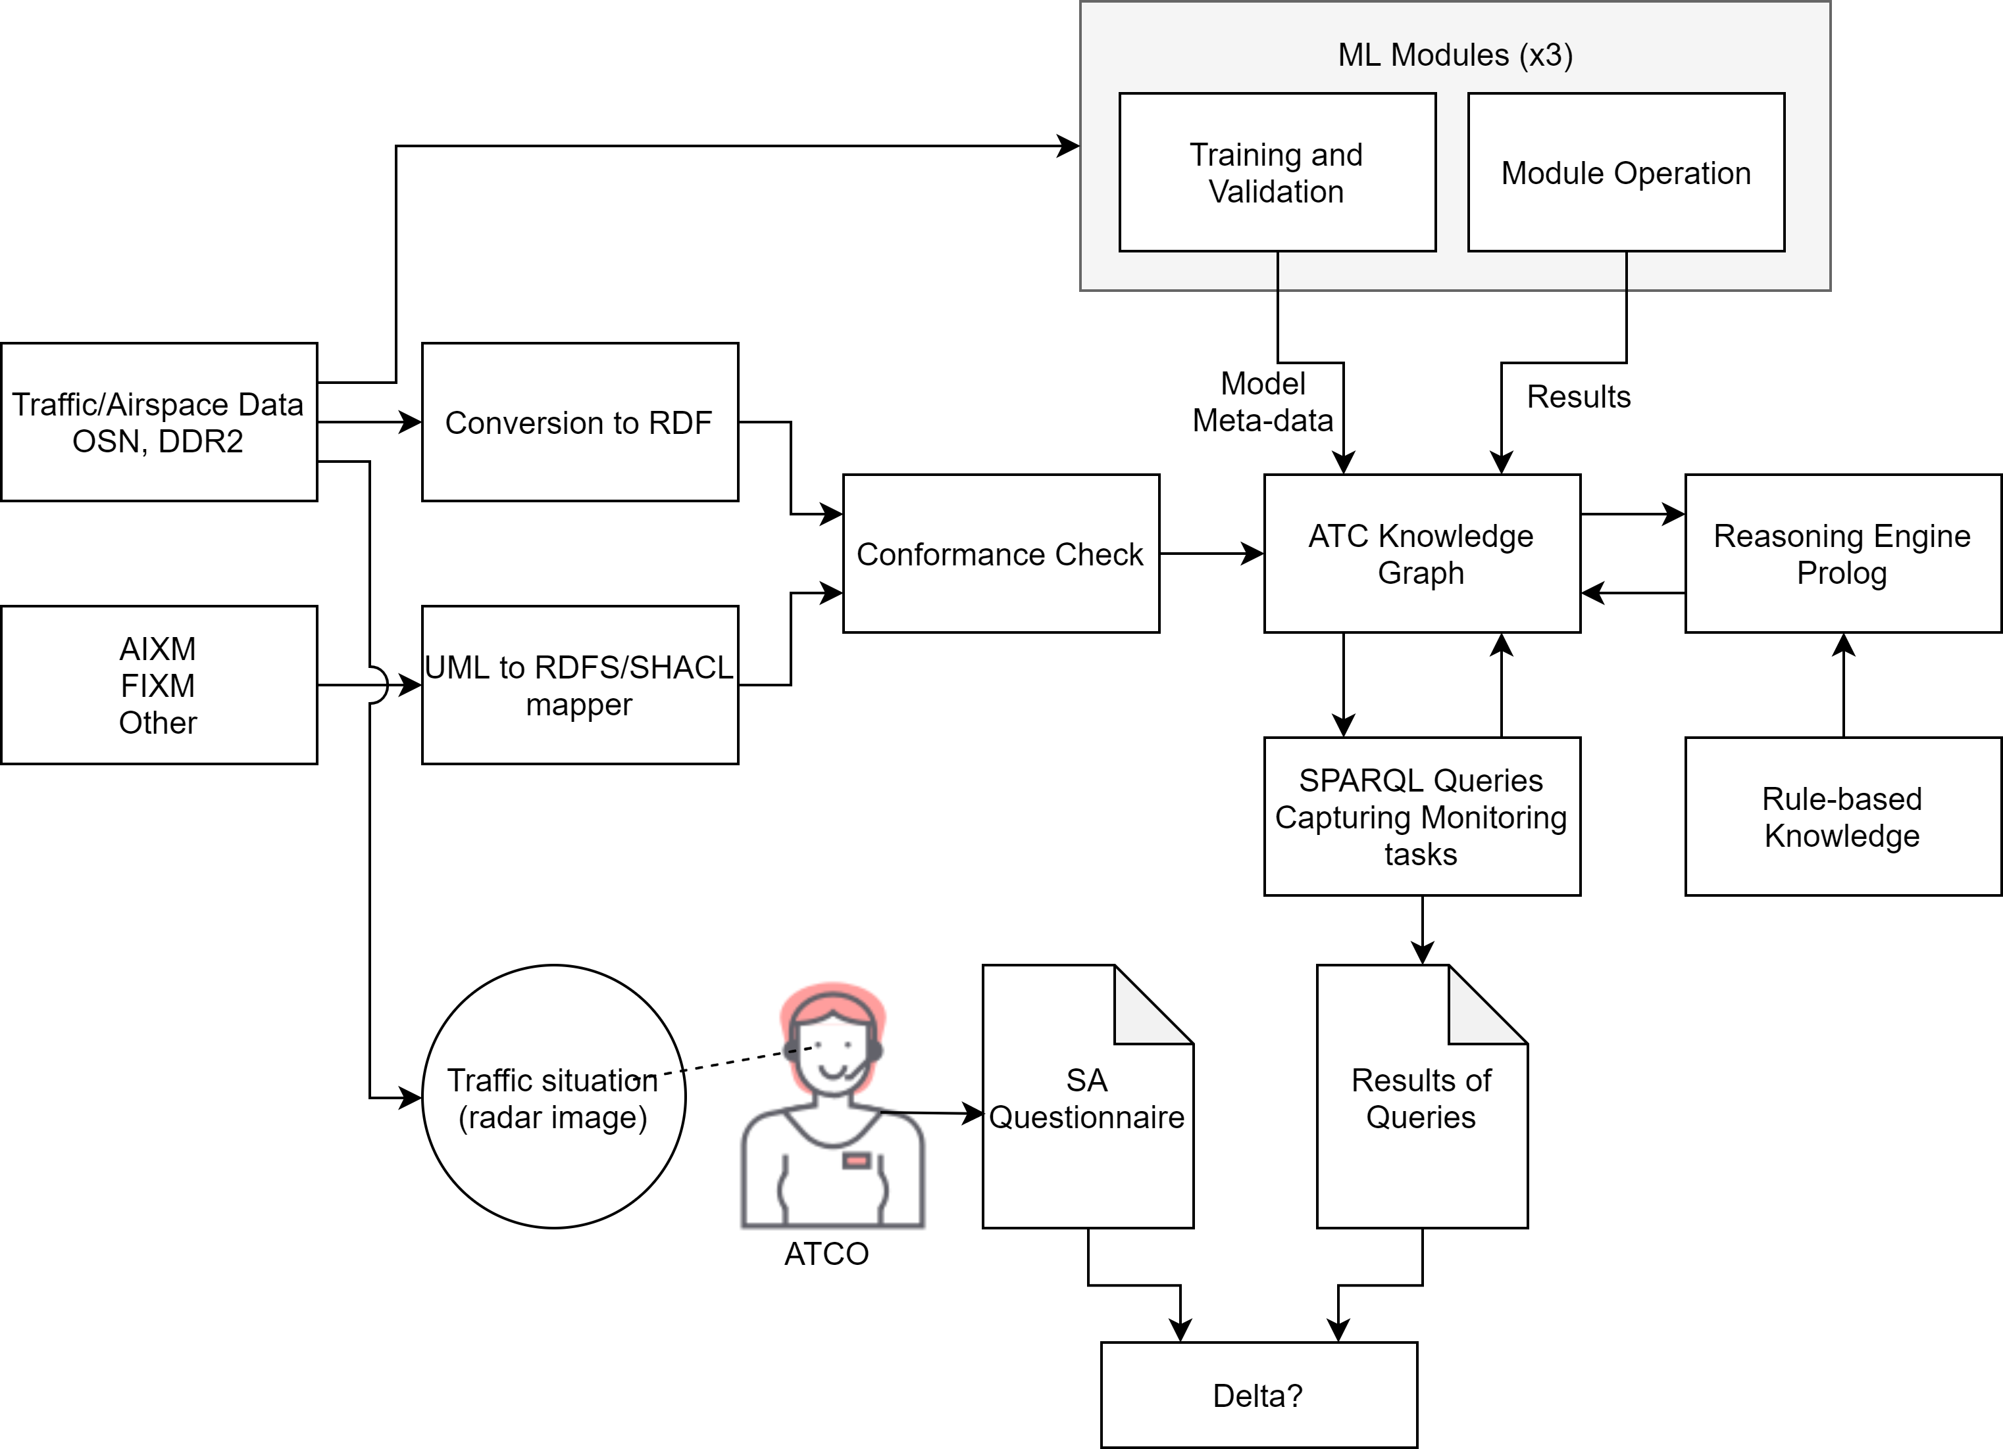
Project Scope

Slide 7
ATCO Tasks Define the Specific Operational Environment
Current
Task list for current Conops (re-used from previous work, not ours)
2035/2050
Modified task list with best guesses about future ConOps (based on ATM MP and other sources)
AISA ConOps
AISA Future Vision ConOps. How AISA fits into, or upgrades, the 2035/2050 ConOps (+integrated task list)
AISA Project ConOps
AISA Project-level ConOps, PoC KG-based system, integration with ML, monitoring tasks list
Overall 57 tasks proposed for automation via KG-based system
72 Project-level Requirements

Slide 8
AISA Concept Assessment
Risk assessment
Human vs Machine SA
Human-Machine shared SA

Slide 9
Risk Assessment Goals
To dig into the AISA ConOps and Requirements, to increase the knowledge of AISA by identifying gaps and bounding the AISA development.
Identification of potential hazards for AISA system.
Proposal of mitigation measures that could be potential safety requirements in the further development of AISA.
Notes:
What are the goals of the risk assessment and why do we do that? Well… leer todo

Slide 10
Risk Assessment
AISA definition
Hazard identification
Identification of hazards that can affect AISA
Hazard analysis
Definition, analysis and contextualization
Risk quantification
Risk quantification based on ICAO methodology
Mitigation measures
Proposal of mitigation measures
Risk assessment
Definition of the risk assessment tasks and limitation of the scope
Description and analysis of the AISA system
Notes:
The risk assessment has been divided into 6 tasks. We have applied the steps proposed by ICAO, so instead of summarizing all of them that comes from the AISA system, identifaction and analysis of hazards, to risk assessment and mitigation measure I am going to explain in more in detail each of them.

Slide 11



Risk assessment conclusions
Results already achieved:
Increase of the AISA’s knowledge system by improving the definition of AISA system
Validation of approach to perform AI risk assessments.
Library of more than 70 risks and hazards
More than 140 mitigation measures for identified risks which could be transformed in further safety requirements
Notes:
Further developments of the AISA system or maybe other AI systems Will take advantage of this risk assessment because:
first, we are identifying which áreas are critical in terms of safety and should be considered during the further design.
Two, some of the mitigation measures could work as safety requirements in the future to be introduced, and could modifiy the current development of the system due to those safety requirements.

Slide 12
AISA Concept Assessment
Risk assessment
Human vs Machine SA
Human-Machine shared SA

Slide 13


EXPERIMENTS AT SKYGUIDE
Experimental Condition:
Experiment 1 (Nov 2021): “without AI SA Input”
N= 20 ATCOs 5 Scenarios 2h
5 interactive
→ post hoc simulations
Experiment 2 (Jan 2022): “with AI SA Input”
N= 16 ATCOs 5 Scenarios 2h
1 interactive 4 watch-only
a → Assessment of ATCO judgment on machine SA

Slide 14
EXPERIMENTAL SETUP TO COLLECT DATA
Attachement of sensors & starting recordings
ET recording start
Removing sensors & stop recordings
Introduction
Training
Scenario 1
Scenario 2
…
Scenario 5
Debriefing
Questionnaire:
Socio-Demographics
Physical Condition and Fatigue
Personal Questions
SASHA_Q (rating)
AI input rating (exp 2)
SASHA_L (queries)
ISA Workload

Slide 15
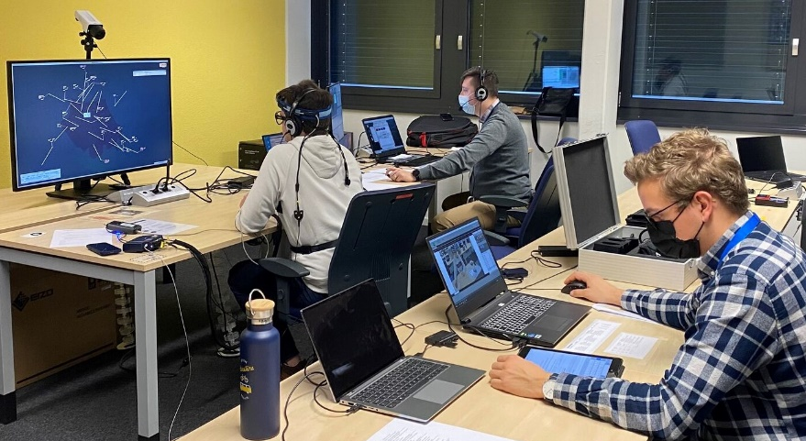
SCENERY
Photo of experimental run in January 2022: One of two stations with participating ATCO, pseudo pilot, assisting scientist and SME ATCO (not visible)

Slide 16
Results of Knowledge Graph and Task Analysis
Experiment 1 (without AISA input)
20 scenarios, 1 from each ATCO, randomly selected
Objective situation awareness indicators
Identification of non-compliance (hdg, speed, level)
Flights assumed (accepted) – flights transferred
QoS opportunities
NOT a test of ATCO performance; ATCOs are just a baseline for this particular experiment

Slide 17
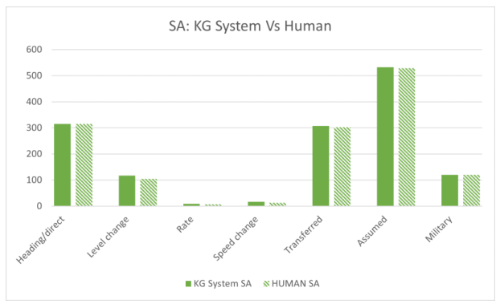
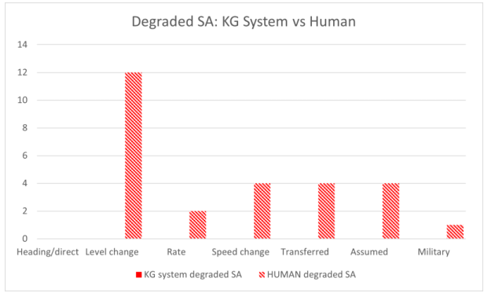
Results of Knowledge Graph and Task Analysis

Slide 18
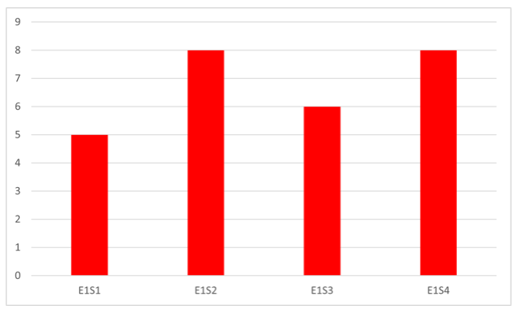
Results of Knowledge Graph and Task Analysis
The overall number of occurrences of degraded human SA (per scenario type)
Out of 1400+ events over 20 scenarios:
27 times human SA was degraded
0 times for machine

Slide 19
AISA Concept Assessment
Risk assessment
Human vs Machine SA
Human-Machine shared SA

Slide 20
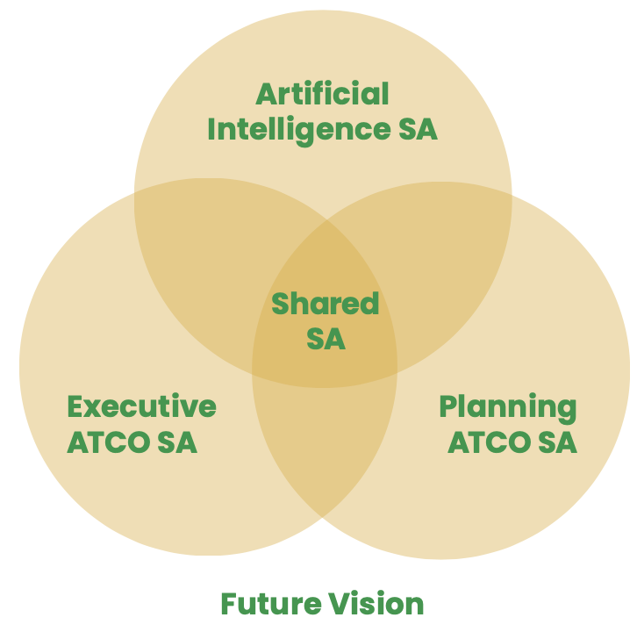
Build Human-Machine Team Situation Awareness
Human intuition
Selective attention
Fast recognition
Naturalistic decision making (if-then-rules)
Machine scrutiny
Exhaustive scanning
Comprehensive monitoring
Long-term prediction

Slide 21

Machine SA Inputs = Query Answers (SASHA_L)
AI inputs provided orally during simulation upon ATCOs’ query answer concerning …
Conflicts
Non-conformances
Optimized service
Examples:
Crossing between … IBK1CH & TVF4740 in 5 minutes BAW842P & IBK1CH in 6 minutes BTI8EP & FPO85J in 8 minutes RYR5QX & TVF4740 in 8 minutes
Non-conformance: Flight level bust TVF31WW

Slide 22
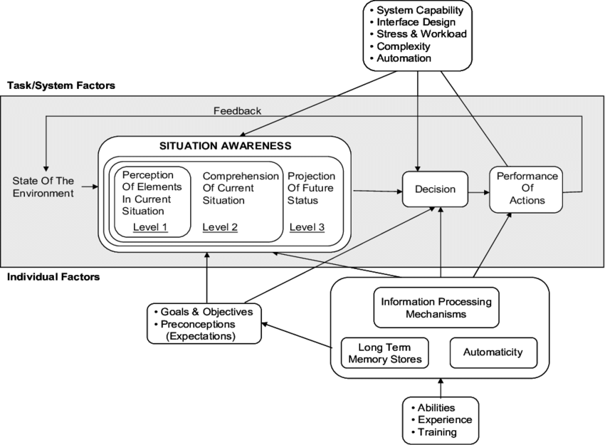
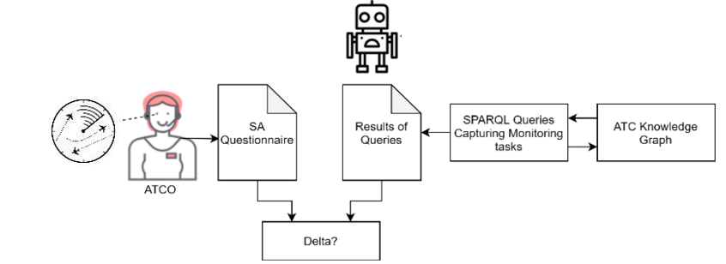
Variables
Situation Awareness of ATCO
Comparsion of SA: ATCO vs. AI SA system
Methods:
Subjective Rating (SASHA_Q)
Gaze-based indicators for SA (Eye-Tracking)
Implicit performance measures for SA (behavioural observation)
Probe technique for SA (SASHA_L) e.g. ‘’Do you see any non-conformance?’’

Slide 23
Intercorrelation of SA Measurements
Table: Pearson correlations between SA measurements in experiment 2
Interactive Scenario (E2S2.1 Crossing) | Self-Rating: SASHA_Q [score] N=16 | Query: SASHA_L Correct [%] N=16 | Gaze-based: ET Conflict Detection [min] N=14 | Implicit SA: conflict duration [min] N=14
Self-Rating: SASHA_Q [score] | 1 | 0.1508 | -0.0621 | -0.1985
Query: SASHA_L Correct [%] |  | 1 | -0.7932*** | -0.7095**
Gaze-based: ET Conflict Detection [min] |  |  | 1 | 0.8538***
Implicit SA : Conflict Duration [min] |  |  |  | 1
* p < 0.05; ** p < 0.01; *** p < 0.001

Slide 24

Results: Comparison of AI and Human SA
Comparison of AI SA system outputs with ATCO answers on identical queries
SA aspects concerning crossings, non-conformances, optimized quality of service
Are Machine SA and ATCO SA comparable? AI SA system
detected all but one SA query aspects – also at early stage of implementation
produced errors (false alarms and one miss)
ATCOs
On average named 50% of all SA query aspects
produced errors (false alarms and misses)
Can the AI SA system provide inputs that ATCOs were not aware of?
AI SA system could provide inputs on SA that ATCOs did not mention

Slide 25

Results: Impact of IA Input on Human Performance
Table: Comparison of ATCO performance “without” and “with AI SA inputs”
 | Conflict Duration [sec] |  | Start of Solution [sec]
Conflict | Without input (exp. 1) | With AI SA input (exp. 2) | Without input (exp. 1) | With AI SA input (exp. 2)
1. TVF4740 & IBK1CH | 53.4 | 59.4 | 412.13 | 461.41
2. TVF4740 & AFL2548 | 186.6 | 96.6 | 547.81 | 533.62
3. FPO85J & BTI8EP | 156.6 | 119.4 | 470.5 | 548.01
Faster conflict solution with AI SA inputs (2 of 3 conflicts).
Onset of conflict solutions not earlier (2 of 3 conflicts).
Notes:
Did AI SA inputs to team SA support ATCOs?
First conflict: With AI SA input ATCOs detected conflicts earlier, if A/C were near sector but did not necessarily solve conflicts earlier.
On average ATCOs with AI SA input solved conflicts more efficiently (less steps to conflict solution) compared to ATCOS without AI SA input.

Slide 26
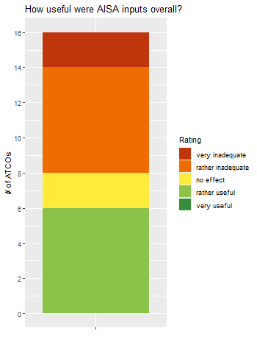
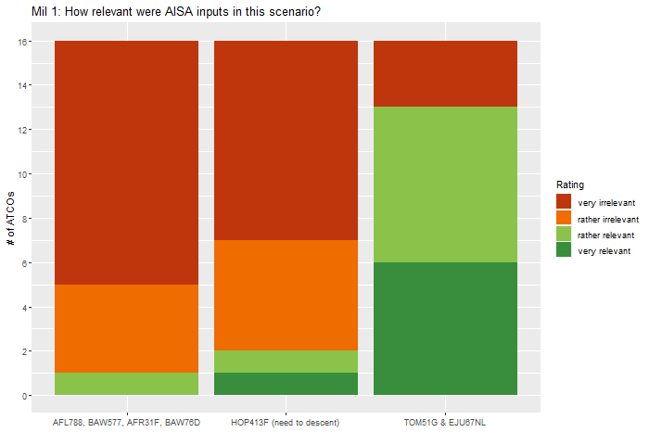
Results: Usefulness of AI SA Inputs
5 = very useful
4
Relevance: ↑ non-obvious
Accuracy > 50% good
Comprehensibility > 60%
Trust: ↓ for some inputs
3
4 = very relevant
# of ATCOs
3
2
2
1 = very inadequate
1 = very irrelevant
How useful were
AI SA inputs overall?
Quality of Service
HOP413F (needs to descent)
Exit crossing
(TOM51G & EJU67NL)
How relevant were AI SA inputs in Mil 1 scenario?
Figure: ATCO judgement for each AI SA Inputs after each scenario and in
final debriefing in exp. 2 “with AI SA inputs”
Notes:
How do ATCOs evaluate AI SA inputs’ usefulness and trustworthiness?

Slide 27
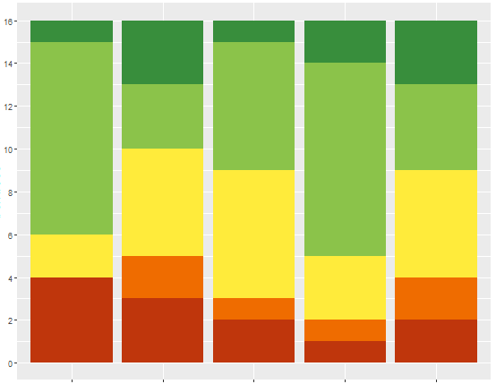
Results: Trust in AI SA inputs
5 = high level of trust
4
Number of ATCOs
3
2
1 = high level of distrust
Crossing
interactive
Crossing
High
Mil 1
Mil 2
watch-only
Figure: How much did you trust the AISA input in the scenario?

Slide 28
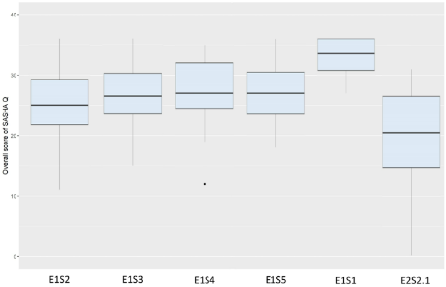
Results: Lower Self-Assessed SA with Machine SA Input
Welch Two Sample t-test:
t= 2.046
df= 27.311
p= 0.05
Overall Score
SASHA_Q
Without
AI support
With
AI support
Figure: Boxplots for mean scale scores for SASHA_Q for all interactive
scenarios in experiment 1 (N=20) and experiment 2 (N=16)
Notes:
Machine Feedback to SA
Liebe Ruth
Du wolltest einmal einen Mittelwert Vergleich zum SASHA Q haben (Crossing Exp 1 vs Exp 2). Ich habe den nun fertig. Gerne können wir am Montag darüber sprechen.
Hier wären nur schon mal die Ergebnisse:
Welch Two Sample t-test data: data$Crossing by data$Experiment t = 2.0461, df = 27.311, p-value = 0.05049 alternative hypothesis: true difference in means between group E1 and group E2 is not equal to 0 95 percent confidence interval: -0.01204355 10.58704355 sample estimates: mean in group E1 mean in group E2: 25.3500 20.0625
Ich wollte dir die Ergebnisse nur zukommen lassen, falls du es für einen Bericht brauchst.
Viele Grüsse Celina

Slide 29
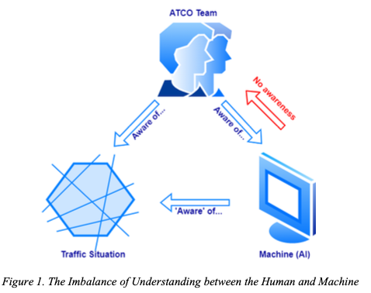
Conclusion and Outlook
Machine SA is accurate with need for improvement on ML module.
Real-time performance is needed.
Improvement of human machine interaction needed → user interface (UI)?
Enable adaptable human-machine collaboration by enabling AI to antici-pate and respond to ATCO needs by understanding human intent and goals.
Expand AI SA system:
ML module to infer human intention from ET data and mouse inputs
Tailor machine SA inputs to ATCO needs: → support ATCO intentions → offer execution of tasks

Slide 30
Questions?

Slide 31
THANK YOU FOR
YOUR ATTENTION

